Slide 1


Parallel Programming With Apache Spark
Reynold Xin

Slide 2
What is Spark?
Fast and Expressive Cluster Computing System Compatible with Apache Hadoop
Efficiency
General execution graphs
In-memory storage
Usability
Rich APIs in Java, Scala, Python
Interactive shell
Up to 10× faster on disk, 100× in memory
2-10× less code
Notes:
Put high-level distributed collection stuff here?

Slide 3






Project History
Spark started in 2009, open sourced 2010
In use at Intel, Yahoo!, Adobe, Alibaba Taobao, Conviva, Ooyala, Bizo and others
Entered Apache Incubator in June

Slide 4
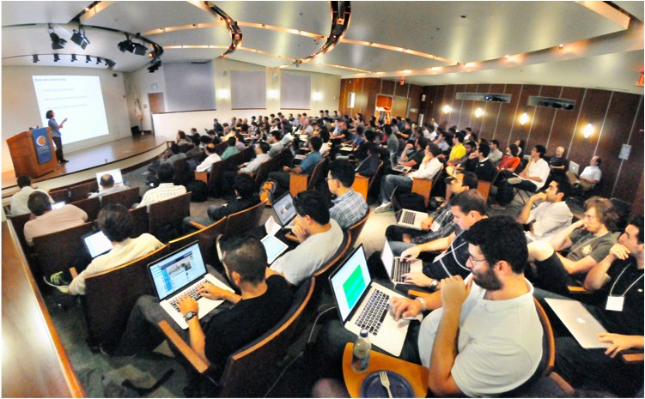








Open Source Community
1300+ meetup members
90+ code contributors
20 companies contributing
Notes:
Alibab, tenzent
At Berkeley, we have been working on a solution since 2009. This solution consists of a software stack for data analytics, called the Berkeley Data Analytics Stack. The centerpiece of this stack is Spark.
Spark has seen significant adoption with hundreds of companies using it, out of which around sixteen companies have contributed back the code. In addition, Spark has been deployed on clusters that exceed 1,000 nodes.

Slide 5
This Talk
Introduction to Spark
Tour of Spark operations (in Python)
Job execution
Standalone apps
Notes:
By the end of this, here’s what you’ll be able to do
Feel free to ask questions in the middle -> on Piazza?

Slide 6
Key Idea
Write programs in terms of transformations on distributed datasets
Concept: resilient distributed datasets (RDDs)
Collections of objects spread across a cluster
Built through parallel transformations (map, filter, etc)
Automatically rebuilt on failure
Controllable persistence (e.g. caching in RAM)

Slide 7
Operations
Transformations (e.g. map, filter, groupBy)
Lazy operations to build RDDs from other RDDs
Actions (e.g. count, collect, save)
Return a result or write it to storage
Notes:
You write a single program → similar to DryadLINQ
Distributed data sets with parallel operations on them are pretty standard; the new thing is that they can be reused across ops
Variables in the driver program can be used in parallel ops; accumulators useful for sending information back, cached vars are an optimization
Mention cached vars useful for some workloads that won’t be shown here
Mention it’s all designed to be easy to distribute in a fault-tolerant fashion

Slide 8

Example: Log Mining
Load error messages from a log into memory, then interactively search for various patterns
Base RDD
Transformed RDD
Cache 1
lines = spark.textFile(“hdfs://...”)
errors = lines.filter(lambda s: s.startswith(“ERROR”))
messages = errors.map(lambda s: s.split(“\t”)[2])
messages.cache()
Worker
results
tasks
Block 1
Driver
Action
messages.filter(lambda s: “foo” in s).count()
messages.filter(lambda s: “bar” in s).count()
Cache 2
. . .
Worker
Cache 3
Result: full-text search of Wikipedia in 0.5 sec (vs 20 s for on-disk data)
Worker
Block 2
Result: scaled to 1 TB data in 5 sec (vs 180 sec for on-disk data)
Block 3
Notes:
Add “variables” to the “functions” in functional programming

Slide 9
Fault Recovery
RDDs track lineage information that can be used to efficiently recompute lost data
Ex:
msgs = textFile.filter(lambda s: s.startsWith(“ERROR”))
.map(lambda s: s.split(“\t”)[2])
HDFS File
Filtered RDD
Mapped RDD
filter (func = _.contains(...))
map (func = _.split(...))

Slide 10
Behavior with Less RAM

Slide 11
Spark in Scala and Java
// Scala:
val lines = sc.textFile(...) lines.filter(x => x.contains(“ERROR”)).count()
// Java:
JavaRDD<String> lines = sc.textFile(...); lines.filter(new Function<String, Boolean>() { Boolean call(String s) { return s.contains(“error”); } }).count();

Slide 12
Which Language Should I Use?
Standalone programs can be written in any, but interactive shell is only Python & Scala
Python users: can do Python for both
Java users: consider learning Scala for shell
Performance: Java & Scala are faster due to static typing, but Python is often fine

Slide 13
Scala Cheat Sheet
Variables:
var x: Int = 7 var x = 7 // type inferred
val y = “hi” // read-only
Functions:
def square(x: Int): Int = x*x
def square(x: Int): Int = { x*x // last line returned }
Collections and closures:
val nums = Array(1, 2, 3)
nums.map((x: Int) => x + 2) // {3,4,5} nums.map(x => x + 2) // same nums.map(_ + 2) // same
nums.reduce((x, y) => x + y) // 6 nums.reduce(_ + _) // same
Java interop:
import java.net.URL
new URL(“http://cnn.com”).openStream()
More details: scala-lang.org

Slide 14
This Talk
Introduction to Spark
Tour of Spark operations (in Python)
Job execution
Standalone apps
Notes:
By the end of this, here’s what you’ll be able to do
Feel free to ask questions in the middle -> on Piazza?

Slide 15
Learning Spark
Easiest way: the shell (spark-shell or pyspark)
Special Scala / Python interpreters for cluster use
Runs in local mode on 1 core by default, but can control with MASTER environment var:
MASTER=local ./spark-shell # local, 1 thread MASTER=local[2] ./spark-shell # local, 2 threads MASTER=spark://host:port ./spark-shell # cluster

Slide 16
First Stop: SparkContext
Main entry point to Spark functionality
Available in shell as variable sc
In standalone programs, you’d make your own (see later for details)

Slide 17
Creating RDDs
# Turn a Python collection into an RDD
sc.parallelize([1, 2, 3])
# Load text file from local FS, HDFS, or S3
sc.textFile(“file.txt”)
sc.textFile(“directory/*.txt”)
sc.textFile(“hdfs://namenode:9000/path/file”)
# Use existing Hadoop InputFormat (Java/Scala only)
sc.hadoopFile(path, inputFormat,
keyClass, valClass)

Slide 18
Basic Transformations
nums = sc.parallelize([1, 2, 3])
# Pass each element through a function
squares = nums.map(lambda x: x*x) // {1, 4, 9}
# Keep elements passing a predicate
even = squares.filter(lambda x: x % 2 == 0) // {4}
# Map each element to zero or more others
nums.flatMap(lambda x: => range(x)) # => {0, 0, 1, 0, 1, 2}
Range object (sequence of numbers 0, 1, …, x-1)
Notes:
All lazy

Slide 19
Basic Actions
nums = sc.parallelize([1, 2, 3])
# Retrieve RDD contents as a local collection
nums.collect() # => [1, 2, 3]
# Return first K elements
nums.take(2) # => [1, 2]
# Count number of elements
nums.count() # => 3
# Merge elements with an associative function nums.reduce(lambda x, y: x + y) # => 6
# Write elements to a text file nums.saveAsTextFile(“hdfs://file.txt”)
Notes:
Launch computations

Slide 20
Working with Key-Value Pairs
Spark’s “distributed reduce” transformations operate on RDDs of key-value pairs
Python: pair = (a, b) pair[0] # => a pair[1] # => b
Scala: val pair = (a, b) pair._1 // => a pair._2 // => b
Java: Tuple2 pair = new Tuple2(a, b); pair._1 // => a pair._2 // => b

Slide 21
Some Key-Value Operations
pets = sc.parallelize( [(“cat”, 1), (“dog”, 1), (“cat”, 2)])
pets.reduceByKey(lambda x, y: x + y) # => {(cat, 3), (dog, 1)}
pets.groupByKey() # => {(cat, [1, 2]), (dog, [1])}
pets.sortByKey() # => {(cat, 1), (cat, 2), (dog, 1)}
reduceByKey also automatically implements combiners on the map side

Slide 22
Example: Word Count
lines = sc.textFile(“hamlet.txt”)
counts = lines.flatMap(lambda line: line.split(“ ”)) .map(lambda word: (word, 1)) .reduceByKey(lambda x, y: x + y)
“to” “be” “or”
(to, 1) (be, 1) (or, 1)
(be, 2) (not, 1)
“to be or”
“not” “to” “be”
(not, 1) (to, 1) (be, 1)
(or, 1)
(to, 2)
“not to be”

Slide 23
Other Key-Value Operations
visits = sc.parallelize([ (“index.html”, “1.2.3.4”), (“about.html”, “3.4.5.6”), (“index.html”, “1.3.3.1”) ])
pageNames = sc.parallelize([ (“index.html”, “Home”), (“about.html”, “About”) ])
visits.join(pageNames) # (“index.html”, (“1.2.3.4”, “Home”)) # (“index.html”, (“1.3.3.1”, “Home”)) # (“about.html”, (“3.4.5.6”, “About”))
visits.cogroup(pageNames) # (“index.html”, ([“1.2.3.4”, “1.3.3.1”], [“Home”])) # (“about.html”, ([“3.4.5.6”], [“About”]))

Slide 24
Setting the Level of Parallelism
All the pair RDD operations take an optional second parameter for number of tasks
words.reduceByKey(lambda x, y: x + y, 5)
words.groupByKey(5)
visits.join(pageViews, 5)

Slide 25
Using Local Variables
Any external variables you use in a closure will automatically be shipped to the cluster:
query = sys.stdin.readline() pages.filter(lambda x: query in x).count()
Some caveats:
Each task gets a new copy (updates aren’t sent back)
Variable must be Serializable / Pickle-able
Don’t use fields of an outer object (ships all of it!)

Slide 26
Closure Mishap Example
class MyCoolRddApp { val param = 3.14 val log = new Log(...) ... def work(rdd: RDD[Int]) { rdd.map(x => x + param) .reduce(...) } }
How to get around it:
class MyCoolRddApp { ... def work(rdd: RDD[Int]) { val param_ = param rdd.map(x => x + param_) .reduce(...) } }
NotSerializableException: MyCoolRddApp (or Log)
References only local variable instead of this.param

Slide 27
Other RDD Operators
map
filter
groupBy
sort
union
join
leftOuterJoin
rightOuterJoin
reduce
count
fold
reduceByKey
groupByKey
cogroup
cross
zip
sample
take
first
partitionBy
mapWith
pipe
save
...
More details: spark-project.org/docs/latest/

Slide 28
Demo

Slide 29
This Talk
Introduction to Spark
Tour of Spark operations
Job execution
Standalone apps
Notes:
By the end of this, here’s what you’ll be able to do
Feel free to ask questions in the middle -> on Piazza?

Slide 30
Software Components
Spark runs as a library in your program (1 instance per app)
Runs tasks locally or on cluster
Mesos, YARN or standalone mode
Accesses storage systems via Hadoop InputFormat API
Can use HBase, HDFS, S3, …
Your application
SparkContext
Cluster manager
Local threads
Worker
Worker
Spark executor
Spark executor
HDFS or other storage

Slide 31
Task Scheduler
General task graphs
Automatically pipelines functions
Data locality aware
Partitioning aware to avoid shuffles
B:
A:
F:
Stage 1
groupBy
C:
D:
E:
join
Stage 2
map
filter
Stage 3
= RDD
= cached partition
Notes:
NOT a modified version of Hadoop

Slide 32
Advanced Features
Controllable partitioning
Speed up joins against a dataset
Controllable storage formats
Keep data serialized for efficiency, replicate to multiple nodes, cache on disk
Shared variables: broadcasts, accumulators
See online docs for details!

Slide 33
This Talk
Introduction to Spark
Tour of Spark operations
Job execution
Standalone apps
Notes:
By the end of this, here’s what you’ll be able to do
Feel free to ask questions in the middle -> on Piazza?

Slide 34
Add Spark to Your Project
Scala / Java: add a Maven dependency on
groupId: org.apache.spark artifactId: spark-core_2.9.3 version: 0.8.0
Python: run program with our pyspark script

Slide 35
Create a SparkContext
import org.apache.spark.SparkContext
import org.apache.spark.SparkContext._
val sc = new SparkContext(“url”, “name”, “sparkHome”, Seq(“app.jar”))
Scala
Cluster URL, or local / local[N]
App name
Spark install path on cluster
List of JARs with app code (to ship)
import org.apache.spark.api.java.JavaSparkContext;
JavaSparkContext sc = new JavaSparkContext(
“masterUrl”, “name”, “sparkHome”, new String[] {“app.jar”}));
Java
from pyspark import SparkContext
sc = SparkContext(“masterUrl”, “name”, “sparkHome”, [“library.py”]))
Python
Notes:
Mention assembly JAR in Maven etc
Use the shell with your own JAR`

Slide 36
Example: PageRank
Good example of a more complex algorithm
Multiple stages of map & reduce
Benefits from Spark’s in-memory caching
Multiple iterations over the same data

Slide 37
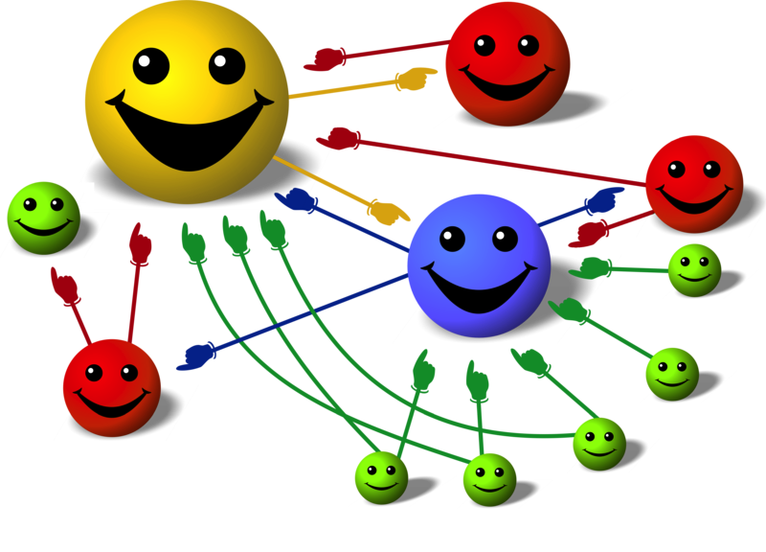
Basic Idea
Give pages ranks (scores) based on links to them
Links from many pages ➔ high rank
Link from a high-rank page ➔ high rank
Image: en.wikipedia.org/wiki/File:PageRank-hi-res-2.png

Slide 38
Algorithm
Start each page at a rank of 1
On each iteration, have page p contribute rank_{p} / |neighbors_{p}| to its neighbors
Set each page’s rank to 0.15 + 0.85 × contribs
1.0
1.0
1.0
1.0

Slide 39
Algorithm
Start each page at a rank of 1
On each iteration, have page p contribute rank_{p} / |neighbors_{p}| to its neighbors
Set each page’s rank to 0.15 + 0.85 × contribs
1.0
1
0.5
1
1.0
0.5
1.0
0.5
0.5
1.0

Slide 40
Algorithm
Start each page at a rank of 1
On each iteration, have page p contribute rank_{p} / |neighbors_{p}| to its neighbors
Set each page’s rank to 0.15 + 0.85 × contribs
1.85
0.58
1.0
0.58

Slide 41
Algorithm
Start each page at a rank of 1
On each iteration, have page p contribute rank_{p} / |neighbors_{p}| to its neighbors
Set each page’s rank to 0.15 + 0.85 × contribs
1.85
0.58
0.5
1.85
0.58
0.29
1.0
0.5
0.29
0.58

Slide 42
Algorithm
Start each page at a rank of 1
On each iteration, have page p contribute rank_{p} / |neighbors_{p}| to its neighbors
Set each page’s rank to 0.15 + 0.85 × contribs
1.31
0.39
. . .
1.72
0.58

Slide 43
Algorithm
Start each page at a rank of 1
On each iteration, have page p contribute rank_{p} / |neighbors_{p}| to its neighbors
Set each page’s rank to 0.15 + 0.85 × contribs
Final state:
1.44
0.46
1.37
0.73

Slide 44
Scala Implementation
val sc = new SparkContext(“local”, “PageRank”, sparkHome, Seq(“pagerank.jar”)) val links = // load RDD of (url, neighbors) pairs
var ranks = // load RDD of (url, rank) pairs
for (i <- 1 to ITERATIONS) {
val contribs = links.join(ranks).flatMap {
case (url, (links, rank)) =>
links.map(dest => (dest, rank/links.size))
} ranks = contribs.reduceByKey(_ + _) .mapValues(0.15 + 0.85 * _)
} ranks.saveAsTextFile(...)

Slide 45
PageRank Performance
Notes:
54 GB Wikipedia dataset

Slide 46
Other Iterative Algorithms
Time per Iteration (s)
Notes:
100 GB datasets

Slide 47
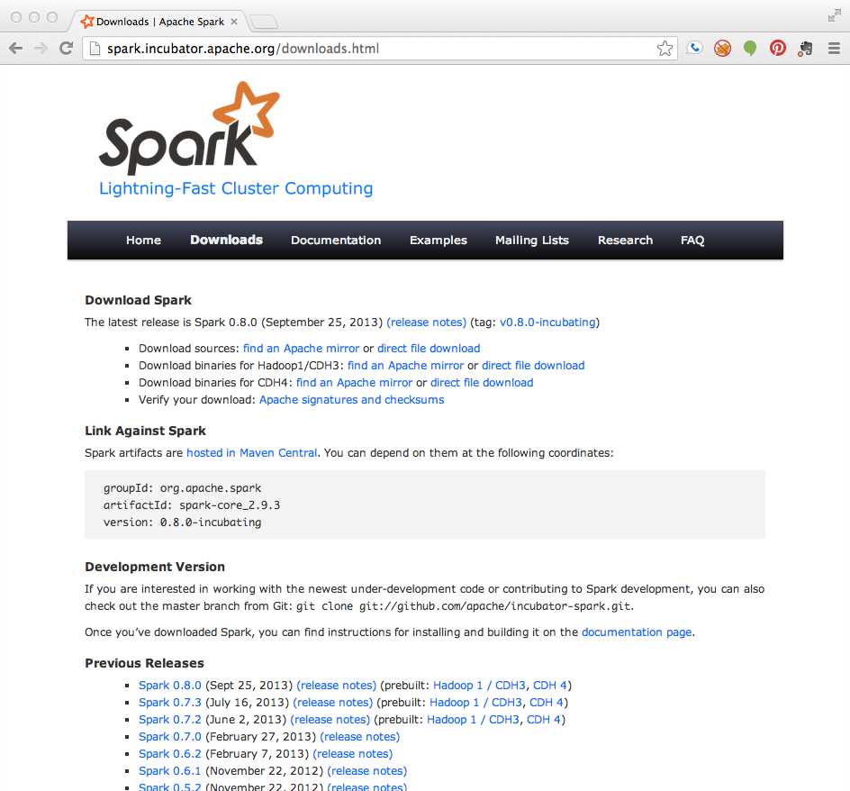
Getting Started
Download Spark: spark-project.org/downloads
Documentation and video tutorials: www.spark-project.org/documentation
Several ways to run:
Local mode (just need Java), EC2, private clusters

Slide 48
Local Execution
Just pass local or local[k] as master URL
Debug using local debuggers
For Java / Scala, just run your program in a debugger
For Python, use an attachable debugger (e.g. PyDev)
Great for development & unit tests

Slide 49
Cluster Execution
Easiest way to launch is EC2: ./spark-ec2 -k keypair –i id_rsa.pem –s slaves \ [launch|stop|start|destroy] clusterName
Several options for private clusters:
Standalone mode (similar to Hadoop’s deploy scripts)
Mesos
Hadoop YARN
Amazon EMR: tinyurl.com/spark-emr

Slide 50

Conclusion
Spark offers a rich API to make data analytics fast: both fast to write and fast to run
Achieves 100x speedups in real applications
Growing community with 20+ companies contributing
www.spark-project.org

